Slide 1

Review Modul12
S T R U K T U R
Lab Dasar FIK - UDINUS

Slide 2


Overview
Structure
Structure Declaration
Typedef
Structure Inisialisation

Slide 3

Structure
A group of various variables with
different data types that relates in one object.
The variables that form a structure is called elements of the structure or field.

Slide 4
Structure Declaration
struct name_struct
{
type_data_member_1 member_name_1 ;
type_data_member_2 member_name_2 ;
type_data_member_3 member_name_3 ;
} ;
Example :
struct biodata
{
int nim;
char *name;
int age;
};

Slide 5



Structure Declaration(2)
Structure Definition
Declare the variable structure typed
Keyword
Name of struct
{ } to begin and end the structure
Each elemen of structure or field
struct biodata student;
Name of struct
Variable structure

Slide 6

Structure Declaration (3)
Define and Declare Structure
struct date {
int day, month, year;
};
struct biodata {
char name[30];
struct date birthday;
};
struct biodata student;
struct biodata {
char name[30];
struct date birthday;
}student;

Slide 7
Typedef
Typedef digunakan untuk membuat identifer sama dengan tipe yang ditentukan.
How to define structures using keyword that provide an alternative name to a type of structure.
Typedef is used to make identifer
equal to the specified type.

Slide 8
Typedef (2)
Example without typedef :
struct biodata {
char name[30];
int age;
};
struct biodata student1;
struct biodata student2;
Example using typedef :
struct biodata {
char name[30];
int age;
};
typedef struct biodata student;
student student1;
student student2;

Slide 9
Typedef (3)
Another way to declare typedef
typedef struct {
char name[30];
int age;
}student;
student student1;
student student2;

Slide 10

Structure Initialisation
Giving element value in structure
Access elements of struture
Example :
  student.birthday.day = 10;
Get the value of structure element
  tgl = student.datelahir.day;
structure_variable.name_element_structure

Slide 11
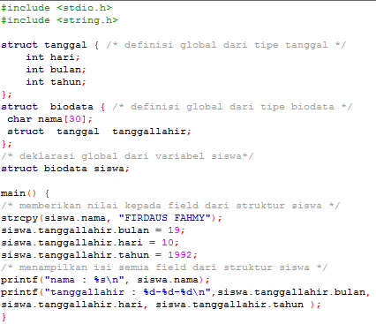
Structure Initialisation(2)

Slide 12
Structure Initialisation(3)
Giving the value of elements in the structure can also be performed directly at the structure declaration
static struct zodiak bintang = {"Sagitarius", 22, 11, 21, 12};

Slide 13
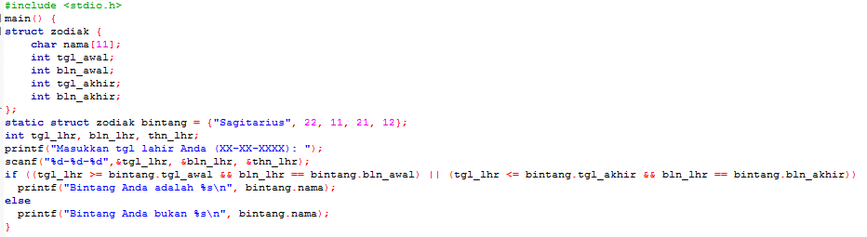
Structure Initialisation(4)

Slide 14
Thank you
~ Have a nice try~

